Slide 1
Differential gene expression between prostate cancer of African American and European American men
TRGN514 Cheng-Hsiang Lu
Notes:
Hello everyone, My name is Sam.
Today, the topic I’m going to talk about is:
“Differential gene expression between prostate cancer of African American and European American men.”

Slide 2
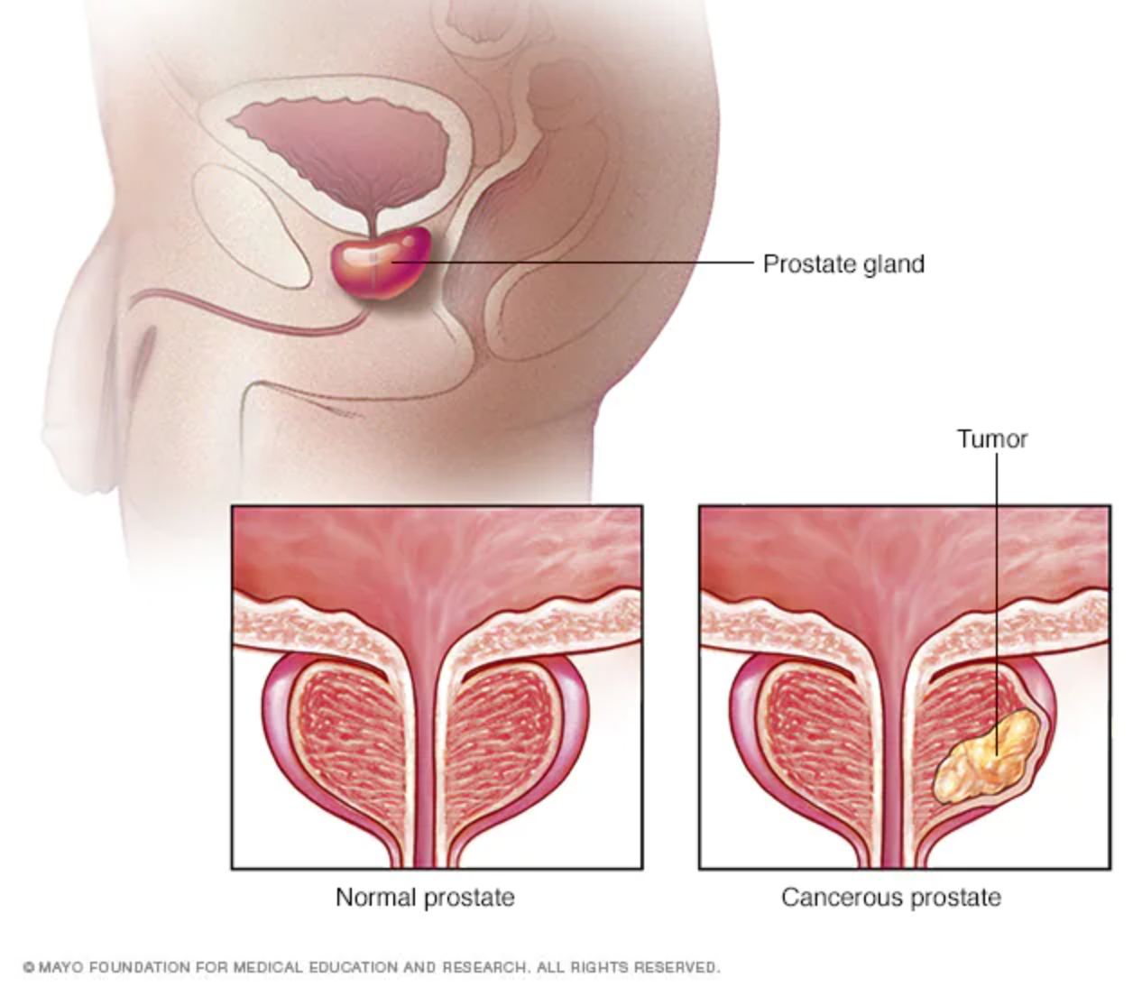
Introduction
Prostate cancer
Prostate cancer is more likely to develop in older men.
Prostate cancer is the second most common cancer in American men.
Prostate cancer is the second leading cause of cancer death in American men.
Men of African origin have 2-3 times greater chance of developing prostate cancer than Men of European origin.
African American men are 2 times more likely to die compared to European American men with prostate cancer.
https://www.cancer.org/cancer/prostate-cancer/about/key-statistics.html
https://www.mayoclinic.org/diseases-conditions/prostate-cancer/symptoms-causes/syc-20353087
Notes:
First, I would like to talk about prostate cancer,
the prostate is a small walnut-shaped gland in males.
It produces the seminal fluid that nourishes and transports sperm.
However, about 12.5% of the male will be diagnosed with prostate cancer during his lifetime.
Especially in older people.
It has been reported that prostate cancer is the second most common cancer in united state.
Besides, it’s also the second leading cause of cancer death in American men.
Based on previous studies,
there is a significant racial disparities in prostate cancer.
The African Americans have a 2–3 times greater chance to have prostate cancer than European Americans,
Besides, African Americans have the highest mortality and lowest survival rates of any race or ethnic group.
They have 2 times greater chance to die compared to those of European origin.
However, recent study lack of the key information that cause the racial disparities.
Especially in genetic studies and clinical trials.

Slide 3
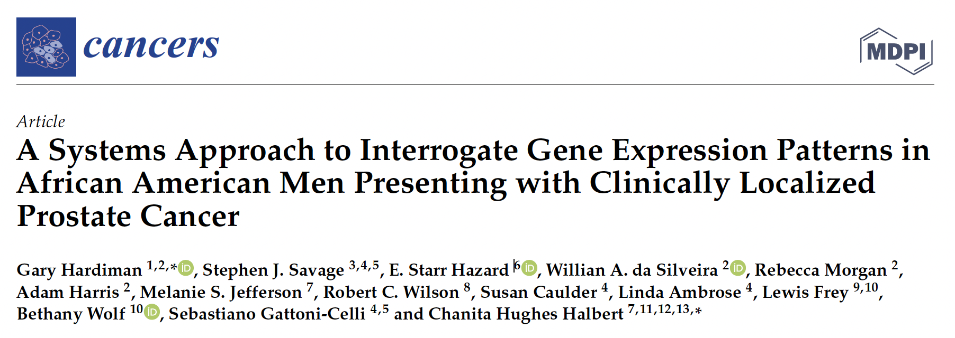
Article
Patients have undergone a prostate biopsy.
33 African American Men and 27 European American men, 60 subjects in total.
My project:
8 samples from African American men.
8 samples from European American men.
These samples included subjects with both high and low vitamin D levels. However, for this project, I only evaluated ancestry and included equal H/L vitamin D subjects in both groups.
Cancers. 2021, 13, 5143
https://www.ncbi.nlm.nih.gov/geo/query/acc.cgi?acc=GSE138503
Notes:
Therefore, I had selected the paper which is “A Systems Approach to Interrogate Gene Expression Patterns in African American Men Presenting with Clinically Localized Prostate Cancer”.
In their paper, they enrolled 60 patients.
Which includes 33 African American Men and 27 European American men.
All of them have undergone prostate biopsy.
In order to compare the genetic profile between African American Man and European American Men,
I randomly selected 16 samples.
So there will be 8 samples from African American Men and 8 samples from European American Men.
These samples included subjects with both high and low vitamin D levels. However, for this project, I only evaluated ancestry and included equal H/L vitamin D subjects in both groups.

Slide 4
Hypothesis
Certain genes are associated with the severity of prostate cancer which cause the racial disparities between African American men and European American men.
Notes:
I hypothesized that
there are certain genes associated with the severity of prostate cancer,
Which will especially expressed in African American men with prostate cancer when comparing to European American men with prostate cancer.

Slide 5
Sequencing source
Series GSE138503
Sample | Sample name | SRA | SRR ID | Single end or paired end | Sample new name
GSM4109968 | AA: 2973__7 | SRX6957518 | SRR10238300 | paired end | AHS1
GSM4109975 | AA: 2980__14 | SRX6957525 | SRR10238307 | paired end | AHS2
GSM4109994 | AA: 3001__38 | SRX6957544 | SRR10238326 | paired end | AHS3
GSM4109997 | AA: 3027__41_S2 | SRX6957547 | SRR10238329 | paired end | AHS4
GSM4109996 | AA: 3026__40_S1 | SRX6957546 | SRR10238328 | paired end | ALS1
GSM4109999 | AA: 3029__43_S4 | SRX6957549 | SRR10238331 | paired end | ALS2
GSM4110002 | AA: 3033__49_S8 | SRX6957552 | SRR10238334 | paired end | ALS3
GSM4110003 | AA: 3034__52_S9 | SRX6957553 | SRR10238335 | paired end | ALS4
GSM4109969 | EA: 2974__8 | SRX6957519 | SRR10238301 | paired end | EHS1
GSM4109973 | EA: 2978__12 | SRX6957523 | SRR10238305 | paired end | EHS2
GSM4109976 | EA: 2981__15 | SRX6957526 | SRR10238308 | paired end | EHS3
GSM4109990 | EA: 2997__34 | SRX6957540 | SRR10238322 | paired end | EHS4
GSM4109967 | EA: 2972__6 | SRX6957517 | SRR10238299 | paired end | ELS1
GSM4110001 | EA: 3031__45_S6 | SRX6957551 | SRR10238333 | paired end | ELS2
GSM4110006 | EA: 3037__56_S12 | SRX6957556 | SRR10238338 | paired end | ELS3
GSM4110008 | AA: 3039__58_S14 | SRX6957558 | SRR10238340 | paired end | ELS4
https://www.ncbi.nlm.nih.gov/geo/query/acc.cgi?acc=GSE138503
Notes:
This is my sequencing data is downloaded form GEO.
The series number is GSE138503.
All my samples sequencing reads are Paired-end.
Each sample is provided with one SRR file.
First, I downloaded and convert SRA files into fastq files by using the sra-toolkit.
I have to use the split files option cause my files are paired-end.
After that, I relabeled all my sample names.
“A” means African American men and “E” means European American men.
Within each group, I’ve selected 4 samples with higher level of vit.D labeled with “H” and 4 samples with lower level of vit.D labeled with “L” .

Slide 6
Pre-alignment sequencing metrics
Read per samples
Maximum | 67,887,728 | AHS2
Minimum | 56,652,656 | ALS3
Mean | 63,855,032
African American
European American
Notes:
This page shows the Number of Read Pairs in all samples before alignment.
Red area is the African American group and the blue area is the European American group.
The maximum Read per sample is 67 millions from AHS2.
The minimum Read per sample is 56 millions from ALS3.
The average Read per sample is 63 millions.

Slide 7
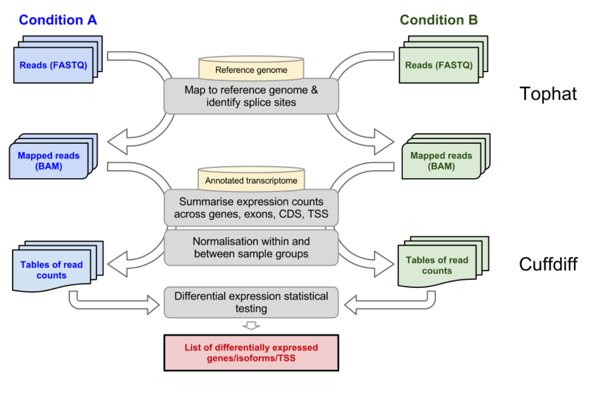
Pipeline
Ref: Homo_sapiens.GRCh38.104.chr.gtf
ensembl.GRCh38.104.fa
Cuffdiff
Stats: gene_exp.diff
noStats: genes.fpkm_tracking
Tophat2
(transcriptome)
Cuffdiff
Stats/noStats
https://www.melbournebioinformatics.org.au/tutorials/tutorials/rna_seq_dge_basic/rna_seq_basic_background/
Notes:
This is the pipeline.
TopHat2 uses the Bowtie2 aligner to align human reference genome; it breaks up the reads that Bowtie2 cannot align on its own into smaller pieces.
TopHat2 use Fasta and Fastq files as an input and got BAM file as an output.
Then, the reads and the reference transcriptome are fed to Cuffdiff.
Cuffdiff inputs Bam files.
And Cuffdiff with Stats outputs statistical values of all samples.
Cuffdiff with no Stats outputs FPKM values for each individual sample.

Slide 8
Alignment metrics and statistics
African American
European American
Maximum(%) | 76.80% | ALS3
Minimum(%) | 69.80% | EHS2
Mean(%) | 72.83%
v
Samples | % Alignment | % Discordance
AHS1 | 73.10% | 1.60%
AHS2 | 71.60% | 0.30%
AHS3 | 74.30% | 0.70%
AHS4 | 73.80% | 0.30%
ALS1 | 72.40% | 0.30%
ALS2 | 70.70% | 0.30%
ALS3 | 76.80% | 0.30%
ALS4 | 72.50% | 0.30%
EHS1 | 71.20% | 0.70%
EHS2 | 69.80% | 0.30%
EHS3 | 75.90% | 0.50%
EHS4 | 74.90% | 0.80%
ELS1 | 71.50% | 0.50%
ELS2 | 73.30% | 0.30%
ELS3 | 71.80% | 0.30%
ELS4 | 71.60% | 0.40%
Average discordance
= 0.49%
Notes:
Now, let’s see the alignment metrics.
The maximum is 76.8% and the minimum is 69.8%.
The average is 72.83% which is no that low.
And the percentage of average Discodance is 0.49% that is a good sign.
A discordant alignment is an alignment where both mates align uniquely, but that does not satisfy the paired-end constraints.

Slide 9
Steps of processing data
Get the FPKM values for all of my samples in genes_fpkm.tracking file(60590 genes)
Remove all zero data(42910 genes).
Add a pseudo count 0.1 to each of my value.
Log10 scale.
Notes:
These are steps that I took to manage my data.
I get the FPKM values for all of my samples in genes_fpkm.tracking file with 60590 genes.
First, I add up all samples and get rid of genes with zero and got 42910 genes.
Then, I add a pseudo count 0.1 to all FPKM value.
Last, I perform all my data on a log10 scale.

Slide 10
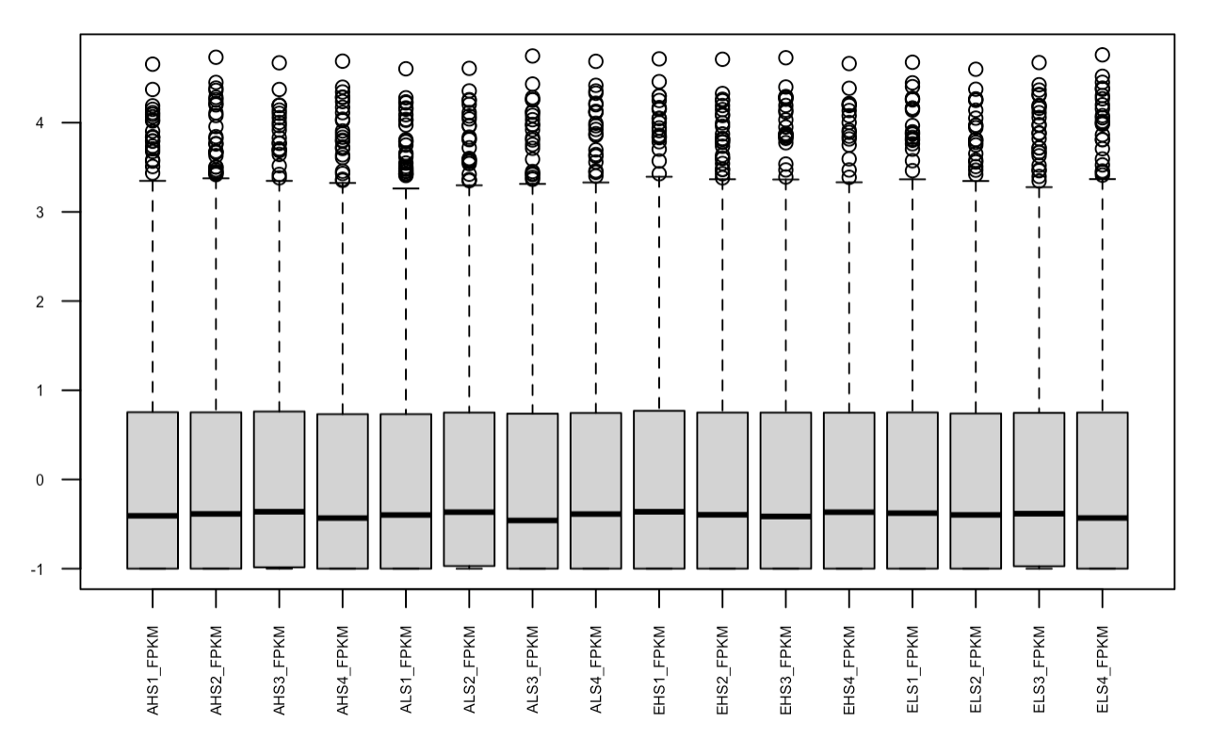
Box and whisker plot
African American
European American
Notes:
This is the Box and whisker plot that I made after the process.
All samples’ labels are listed below.
We see a similar distribution of gene expression across all of my samples which is a good sign.

Slide 11
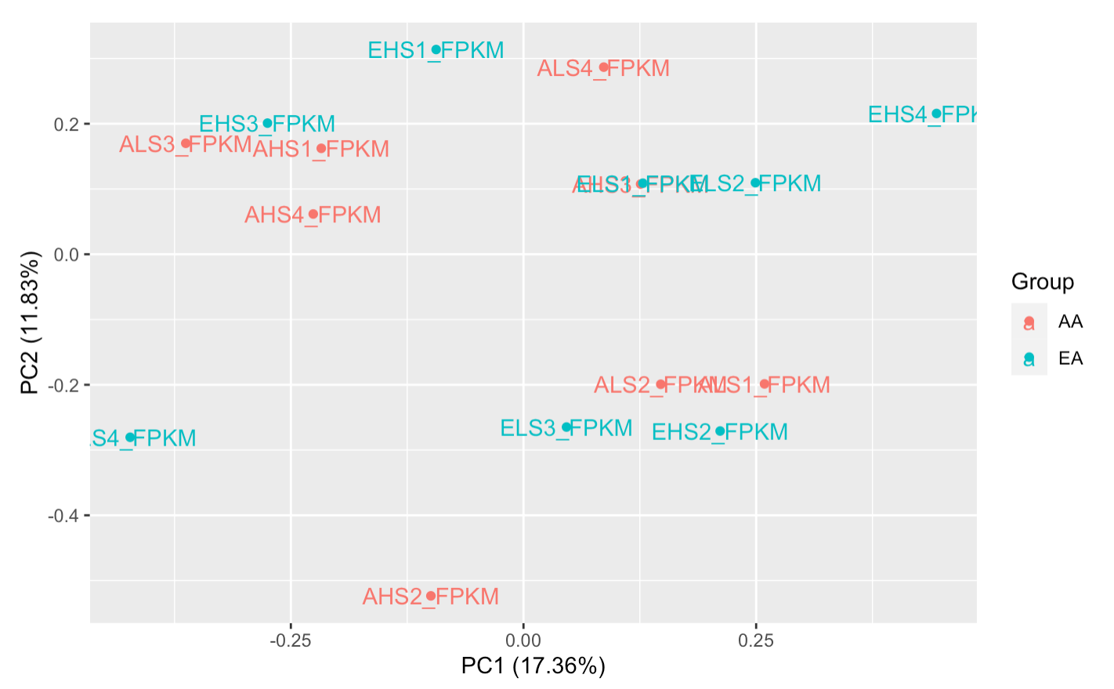
PCA plot
-African American
-European American
Notes:
And this is the PCA plot.
I don’t see any major outliers and there is no big difference between groups right now.
The PC1 shows 17.36%, means they’re 17% of variant that exist.
and the PC2 shows 11.83%.

Slide 12
Filter the data
With p-value
< 0.05
Log2 fold difference
>= +1.5 or <= -1.5
143 genes
51 genes are downregulated
92 genes are upregulated
Notes:
Then, I filtered my data.
With p-value less than 0.05
The Log2-fold difference that I used is greater than or equal to +1.5 or less then or equal to -1.5
Excluding the headers, the Results shows 143 genes.
92 genes are upregulated
And 51 genes are downregulated.

Slide 13
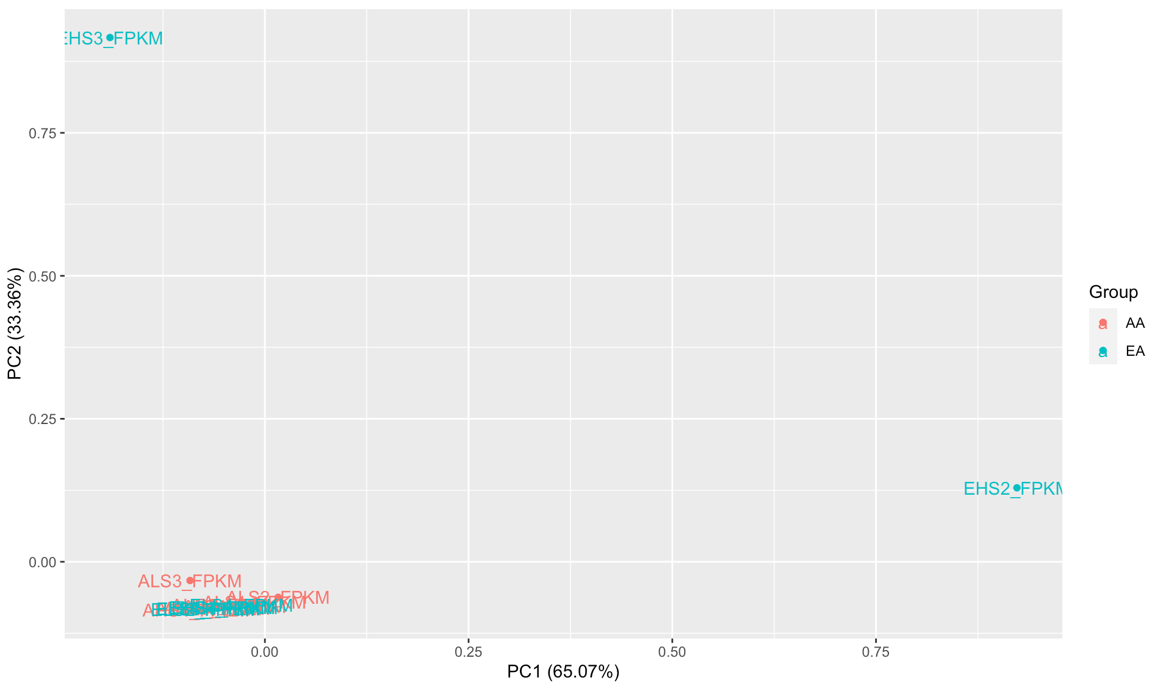
PCA - Filtered Genes
-African American
-European American
Notes:
this is the first PCA plot with filtered genes.
In my hypothesis, I expect that the African American group and the European American group are separated.
However, all of my samples are clustered together due to these two outliers: EHS2 and EHS3.
it is hard to analyze my data and it will affect the rest of the plot.
I went ahead and did pathway analysis on these genes, but all genes we found have big difference due to one or both of these two samples.
And the pathway analysis was not good either because of them.
Therefore, I decided to exclude these two outliers and see what would change.

Slide 14
Remove EHS2/3 and genes without symbol name
With p-value
< 0.05
Log2 fold difference
>= +1.5 or <= -1.5
164 genes
Remove EHS2/3
Remove genes with no symbol name
51 genes are upregulated.
113 genes are downregulated.
Notes:
First, remove EHS2 and EHS3.
p-value and the log2-fold difference stay the same.
Then, remove genes with no symbol name.
the results shows 164 genes.
51 genes are upregulated.
And 113 genes are downregulated.

Slide 15
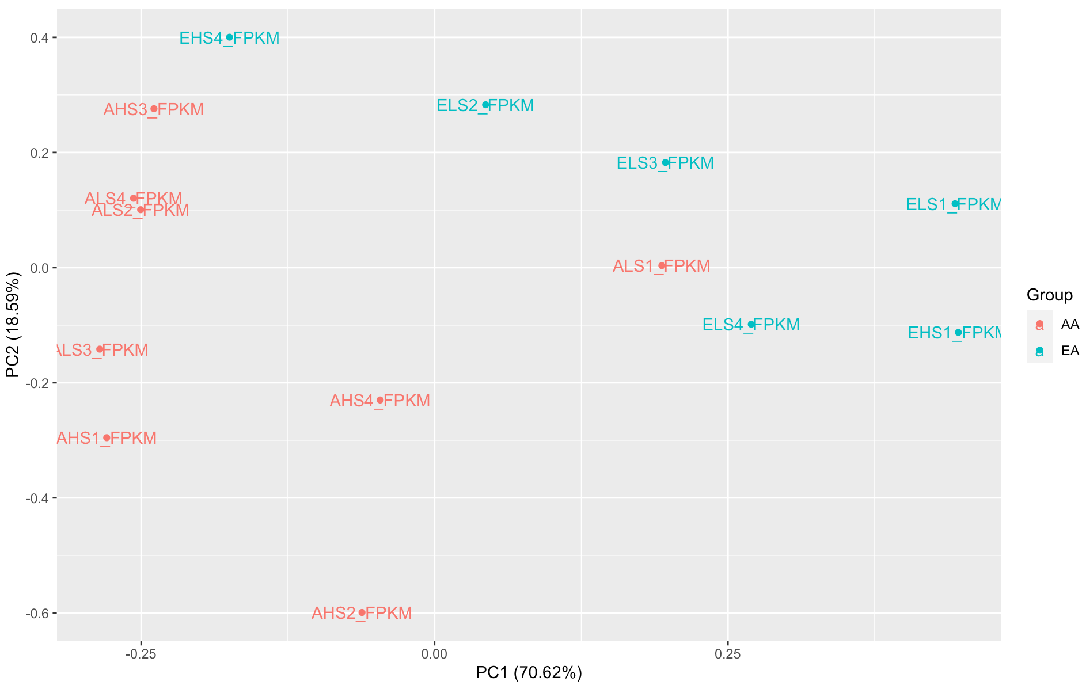
PCA - Filtered Genes
-African American
-European American
Notes:
After excluding these two outliers.
We can see that most of the African Americans are clustered on the left and the European American are clustered on the right side.
Although there are some mixing part in the middle area, it is much better now.
PC1 is about 70% and PC2 is about 18%.

Slide 16
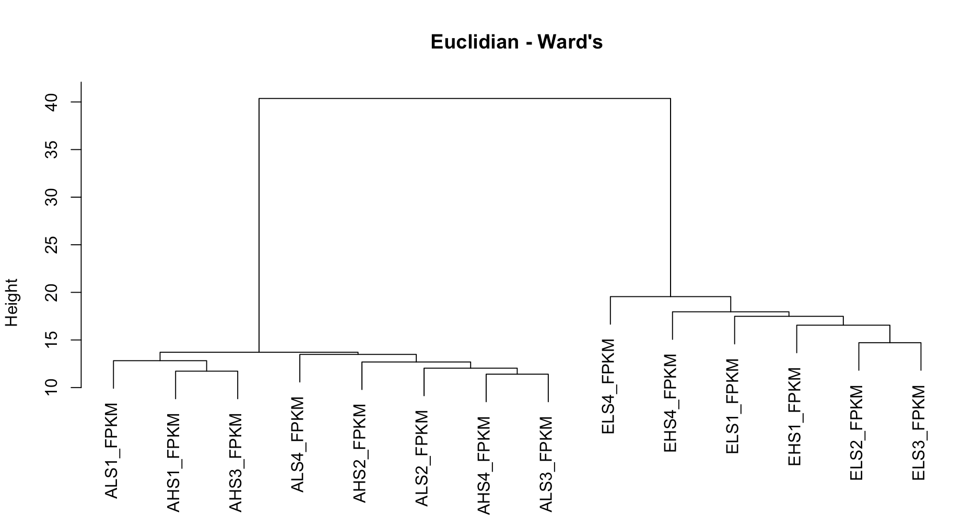
Dendrogram
African American
European American
Notes:
After removing two outliers, this dendrogram can see a clear separation between African American group and European American group.

Slide 17
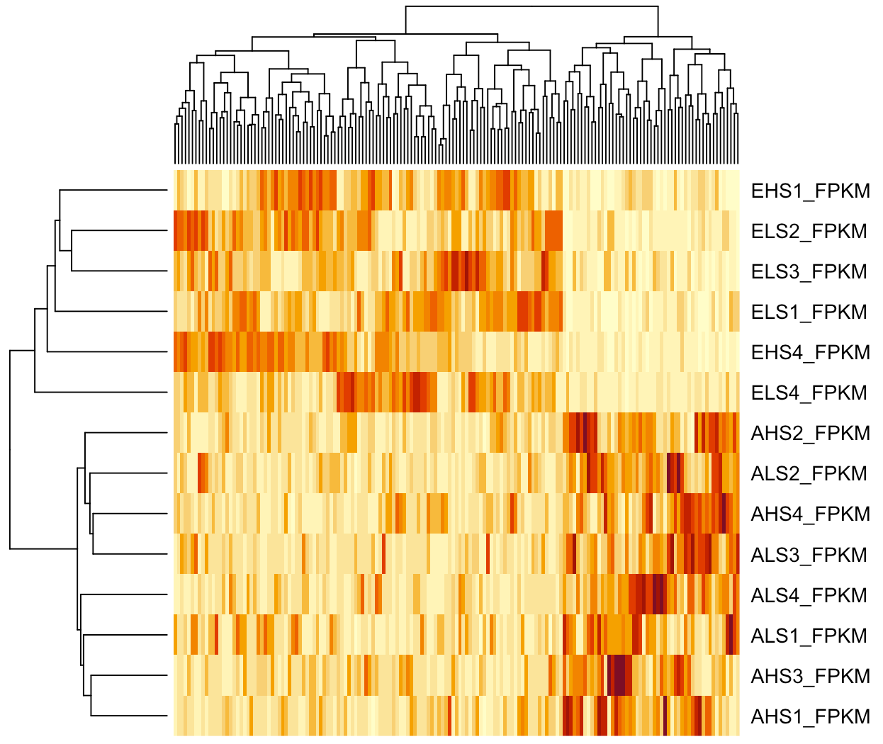
African American
European American
Notes:
This is the heatmap.
From this image, we can see a significant difference of the gene expression pattern between two groups
the separation between African American group and European American group are very clear.

Slide 18
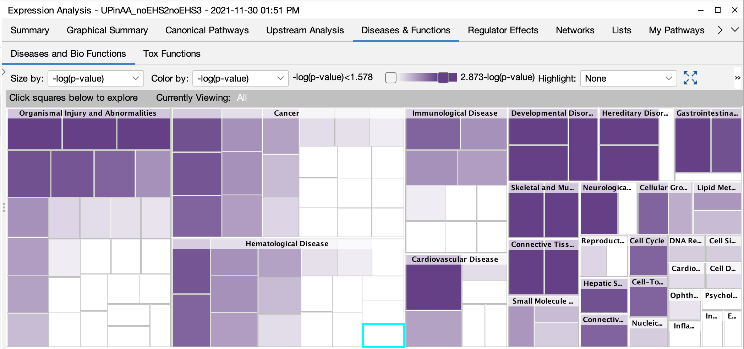
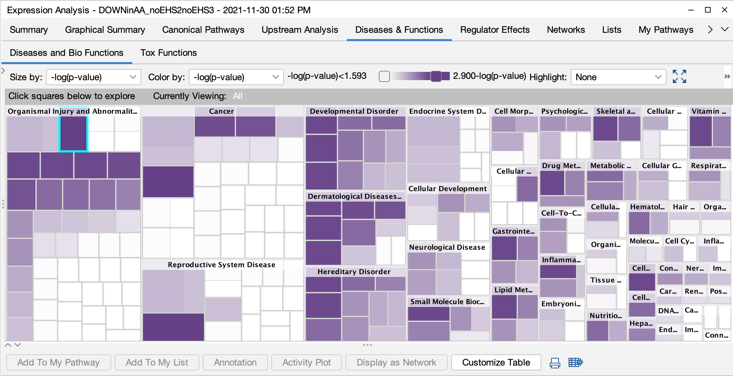
Pathway analysis
Put in upregulated and downregulated genes list separately.
Upregulated genes : 51
Downregulated genes : 113
Notes:
After getting the upregulated and downregulated genes symbol name, I put them in to IPA program separately.
Then I got a upregulated and a down regulated pathway analyses files.

Slide 19
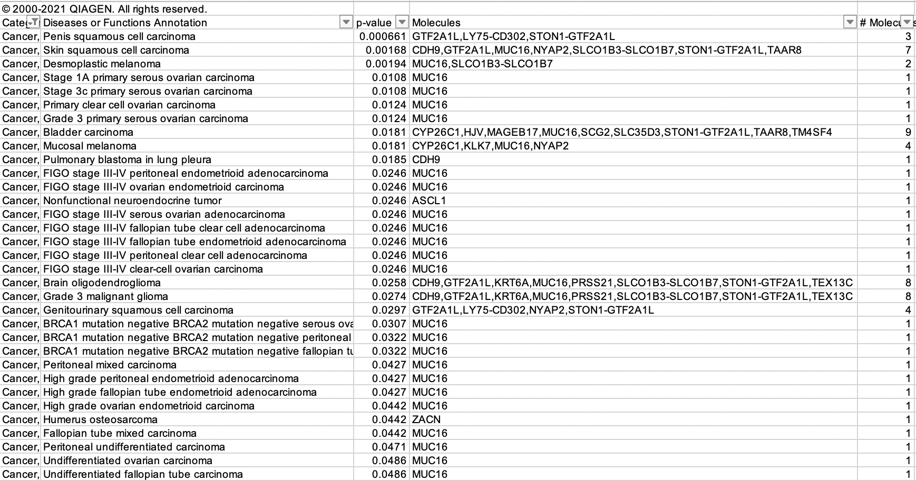
Pathway analysis with downregulated genes
Notes:
With the downregulated genes list,
I filter the category column contain cancer.
This is all the genes show down in African American cancer and up in European American cancer.
So, I listed all genes appeared in the excel and then I’m going to make a heatmap to see if there is any separating between two groups.

Slide 20
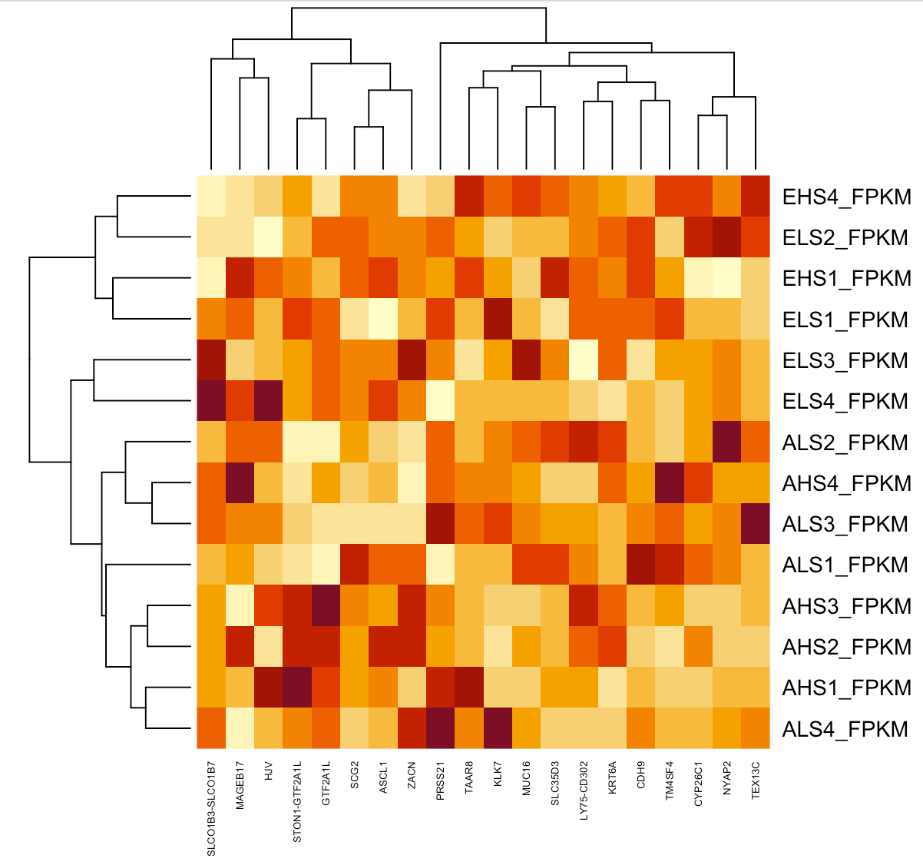
African American
European American
Notes:
This is the heatmap of downregulated genes.
From this image, we can not see a significant difference of the gene expression pattern between two groups.
However, from the dendrogram on the left
We still can slightly see the separation between African American group and European American group.

Slide 21
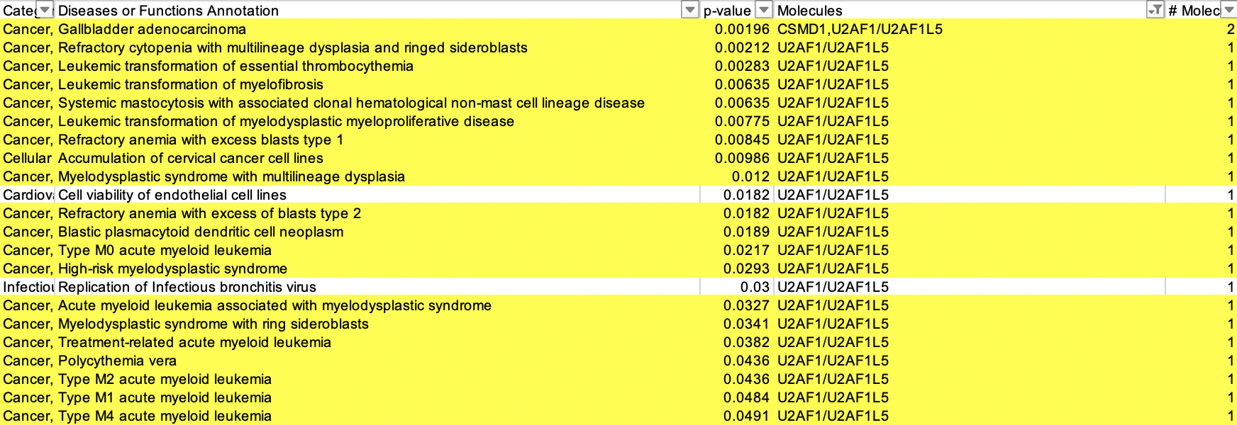
Pathway analysis with upregulated genes
Notes:
With the upregulated genes list,
First, I filter the molecules column with U2AF1L5.
Then, I select the categorices column which contains cancer.
And this is all the pathways. The majority of pathways related to U2AF1L5
And there was one genes RFPL3S that didn’t show in the pathway analysis, but I thought it significant and interested in it.
So I make two barplots with these two genes.

Slide 22
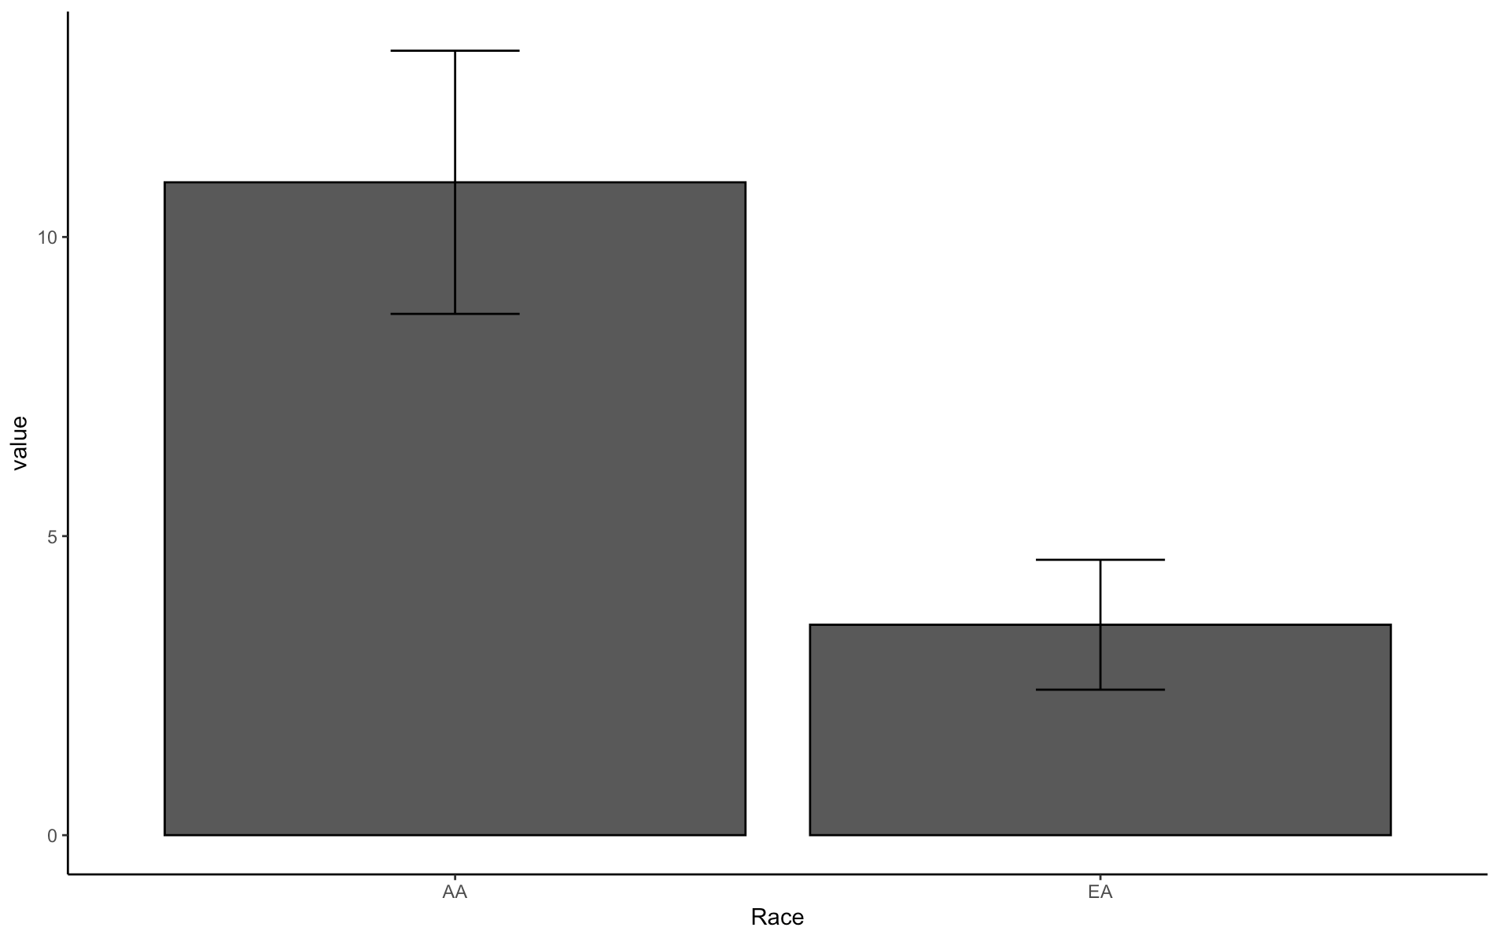
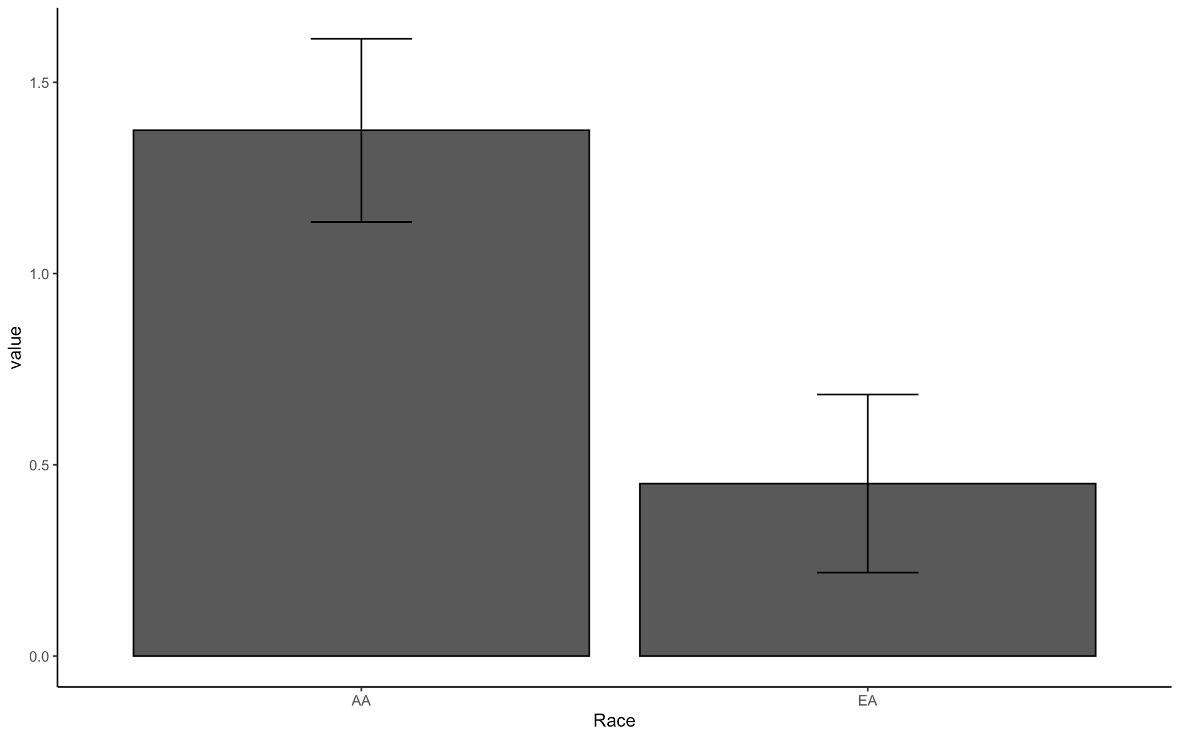
Barplot of RFPL3S and U2AF1L5
RFPL3S
U2AF1L5
1.5
10
P=0.013
P=0.019
1.0
FPKM_value
5
0.5
0
0.0
African American
European American
African American
European American
African American
European American
Notes:
These are barplots.
We can see that the error bar did not overlap, this indicate that they are significantly different.
the African American group shows a higher level of FPKM value than the European American group.
The p-value of RFPL3S is 0.013
The p-value of U2AF1L5 is 0.019

Slide 23
Previous study of genes RFPL3S
RFPL3S was first described in 1999(Seroussi et al, Genome Research) and is a non-coding, antisense transcript of RFLP3 and is located on chr 22. This non-coding gene was produced during evolution from intrachromosomal duplications within the 22q12–13 region, and share an ancestral origin with the highly-variable MHC locus on chr 6.
There is very limited information about RFPL3S function or its role in cancer (there are only three papers on Pubmed).
However, a recent paper (Liu et al, Oncology Letters 2020) showed RFPL3S “was highly expressed in lung cancer tissues when compared with normal tissues and was significantly associated with pN factor, pTNM stage and Ki-67 labeling index.” In addition, “increased RFPL3S expression was associated with poor survival and was inversely associated with first progression in all patients."
Notes:
the previous study mention that RFPL3S was first described in 1999
and is a non-coding, antisense transcript of RFLP3 and is located on chr 22.
This non-coding gene was produced during evolution from intrachromosomal duplications within the 22q12–13 region,
and share an ancestral origin with the highly-variable MHC locus on chr 6.
There is very limited information about RFPL3S function or its role in cancer (there are only three papers on Pubmed).
However, a recent paper showed RFPL3S “was highly expressed in lung cancer tissues when compared with normal tissues and was significantly associated with pN factor, pTNM stage and Ki-67 labeling index.”
In addition, “increased RFPL3S expression was associated with poor survival and was inversely associated with first progression in all patients."

Slide 24
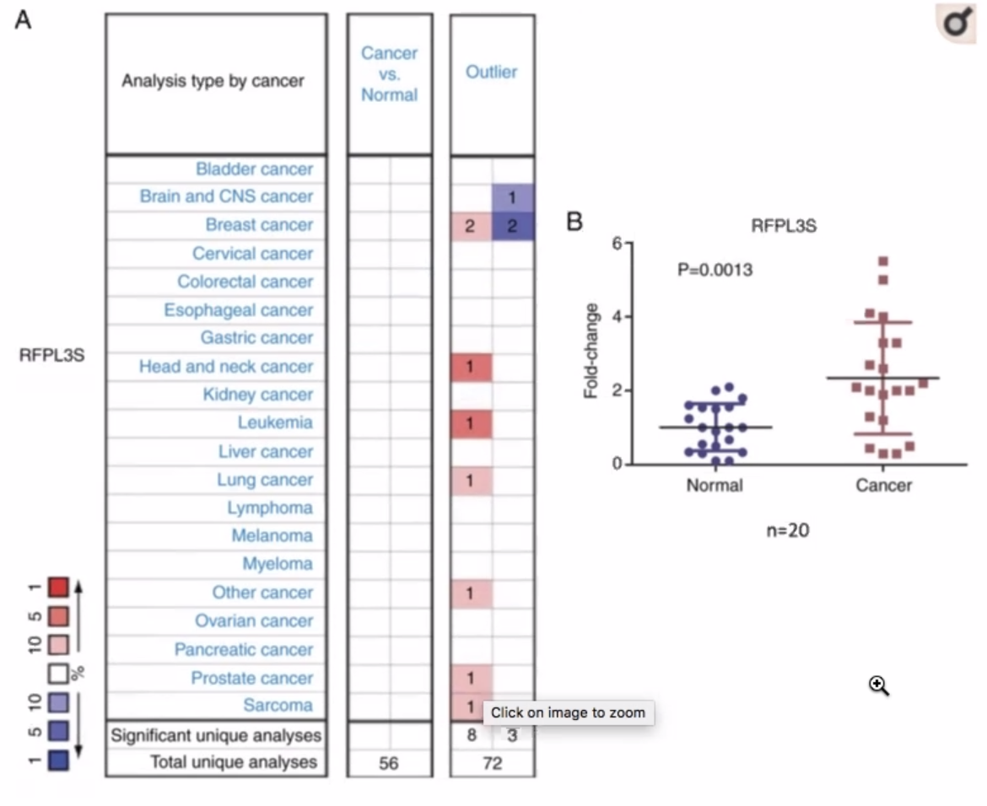
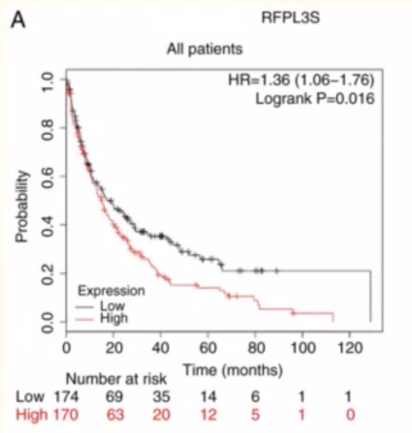
Previous study of genes RFPL3S
Oncol Lett. 2020 Aug; 20(2).
RFPL3S had significantly higher expression in lung cancer than normal lung tissue.
High RFLP3S expression Is associated with poor survival in lung cancer.
Notes:
We can see the figure on the left.
RFPL3S had significantly higher expression in lung cancer than normal lung tissue.
And the figure on the right shows that High RFLP3S expression Is associated with poor survival in lung cancer.

Slide 25
Previous study of gene U2AF1L5
U2AF1L5 (U2 Small Nuclear RNA Auxiliary Factor 1 Like 5) is a Protein Coding gene and plays a critical role in RNA splicing and is located on chr 21. (https://www.genecards.org/cgi-bin/carddisp.pl?gene=U2AF1L5)
There is very limited information about U2AF1L5 function or its role in cancer (there are only two papers on Pubmed).
However, a recent paper (Zhao et al, Frontiers in Oncology 2021) using machine learning from Nasopharyngeal carcinoma (NPC) RNA-Seq data identified U2AF1L5 as one of four genes able to predict NPC recurrence/metastasis. “Of the four mRNAs, two were protective mRNAs (GLB1L and MLF1) whose high expression was associated with better prognosis. In contrast, high expression of the remaining two mRNAs (U2AF1L5 and TMEM265) was associated with poor outcomes.”
Notes:
Next, I will introduce the previous study of gene U2AF1L5.
U2AF1L5 is a Protein Coding gene and plays a critical role in RNA splicing and is located on chr 21.
There is very limited information about U2AF1L5 function or its role in cancer (there are only two papers on Pubmed).
However, a recent using machine learning from Nasopharyngeal carcinoma (NPC) RNA-Seq data identified U2AF1L5 as one of four genes able to predict NPC recurrence/metastasis.
“Of the four mRNAs, two were protective mRNAs (GLB1L and MLF1) whose high expression was associated with better prognosis.
In contrast, high expression of the remaining two mRNAs (U2AF1L5 and TMEM265) was associated with poor outcomes.”

Slide 26
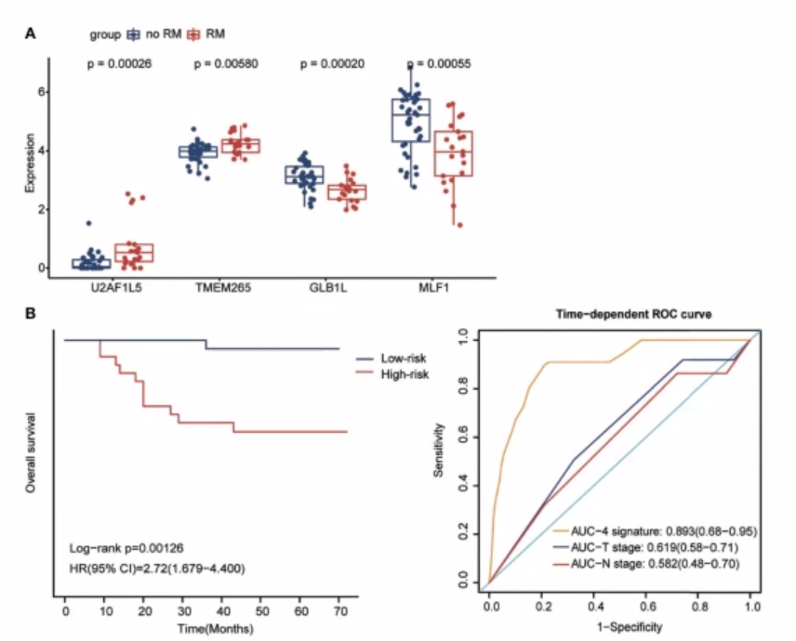
Previous study of genes U2AF1L5
Front. Oncol. 2021 August 07.
U2AF1L5 was expressed higher in NPC that had recurrence/metastasis (RM) compared to NPC with no RM.
A 4-gene machine learning model that includes U2A51LF was associated with NPC patient survival.
Notes:
We can see the figure on the left shows U2AF1L5 was expressed higher in NPC that had recurrence/metastasis (RM) compared to NPC with no RM.
And the figure on the right stats
A 4-gene machine learning model that includes U2A51LF was associated with NPC patient survival.

Slide 27
Conclusions & future studies
Conclusions
RFPL3S and U2AF1L5 were expressed significantly higher in the African American group than the European American group.
Limited information is available about these genes’ function.
However, two recent studies in lung cancer and Nasopharyngeal carcinoma (NPC) support the hypothesis that increased the expression of these genes is associated with recurrence, metastasis, and poor survival.
I hypothesize that the health disparity observed in African American men with prostate cancer may be due to higher expression of these genes, and that they may be useful markers for prostate cancer prognosis and/or may served as novel drug-treatment targets. This data suggests that differential gene expression between African American men and European American men may influence the severity and survival of prostate cancer.
Future studies
Assess RFPL3S and U2AF1L5 expression in additional samples or independent datasets.
Perform laboratory studies in cancer cell lines or animal models to determine the effect of RFPL3S and U2AF1L5 overexpression.
Evaluate if RFPL3S and U2AF1L5 expression is related to vitamin D levels (another part of this dataset that was not analyzed for my project).
Notes:
In conclusion,
RFPL3S and U2AF1L5 were expressed significantly higher in the African American group than the European American group.
And Limited information is available about these genes’ function.
However, two recent studies in lung cancer and Nasopharyngeal carcinoma (NPC) support the hypothesis that increased the expression of these genes is associated with recurrence, metastasis, and poor survival.
I hypothesize that the health disparity observed in African American men with prostate cancer may be due to higher expression of these genes,
and that they may be useful markers for prostate cancer prognosis and/or may served as novel drug-treatment targets.
This data suggests that differential gene expression between African American men and European American men may influence the severity and survival of prostate cancer.
In Future studies,
Assess RFPL3S and U2AF1L5 expression in additional samples or independent datasets.
Perform laboratory studies in cancer cell lines or animal models to determine the effect of RFPL3S and U2AF1L5 overexpression.
Last, Evaluate if RFPL3S and U2AF1L5 expression is related to vitamin D levels.

Slide 28
Thank you.
Notes:
I would like to thank Dr. Hjelm help me overcome every obsticles that I encountered and help me finish this final project even though I’m rookie in the field.
And Thank you for your listening.

